Slide 1

ELM 12-05 Pressure Relief Rates
June 2024

Slide 2
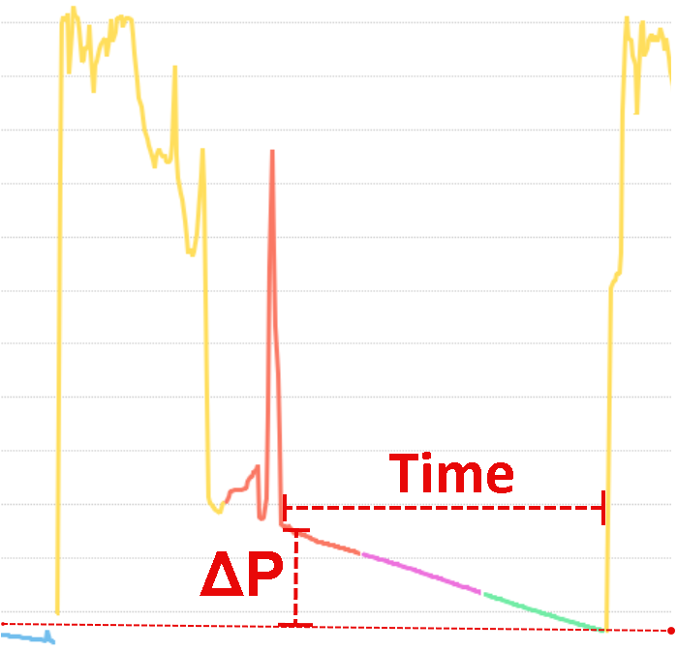
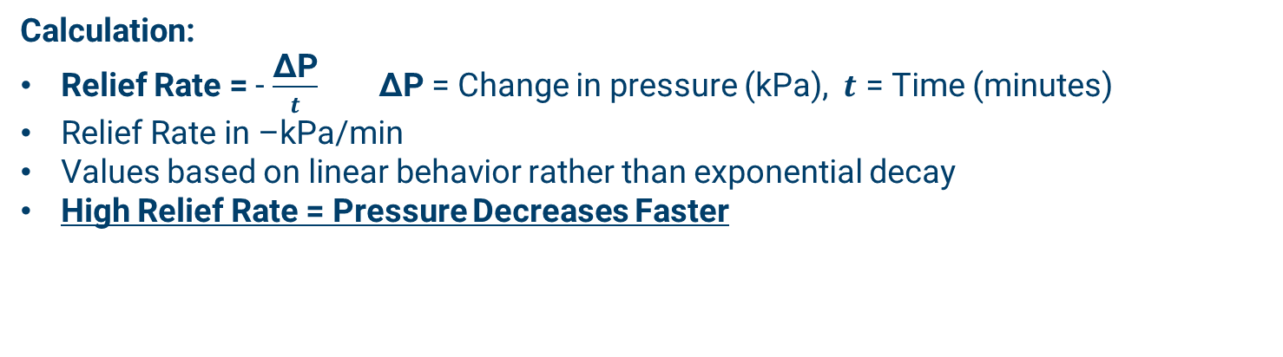
Pressure Relief Rate Calculations
Methodology
Calculation:
Relief Rate = - $\frac{\text{Δ}\text{P}}{t}$ $\text{Δ}\text{P}$ = Change in pressure (kPa), $t$ = Time (minutes)
Relief Rate in –kPa/min
Values based on linear behavior rather than exponential decay
High Relief Rate = Pressure Decreases Faster
Python Script Workflow:
Pressure Decline Detection: Identifies sustained periods of pressure decline using a rolling average and compares these declines against a set threshold to validate data
Relief Rate Calculation: For each decline period, it calculates the relief rate (drop in pressure per minute)
Stage Assignment: Relief rates are assigned to corresponding stages based on the stage end times

Slide 3
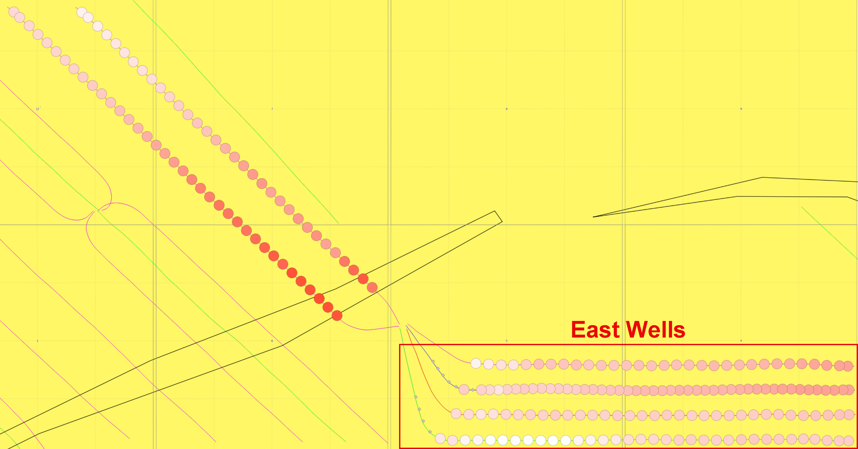
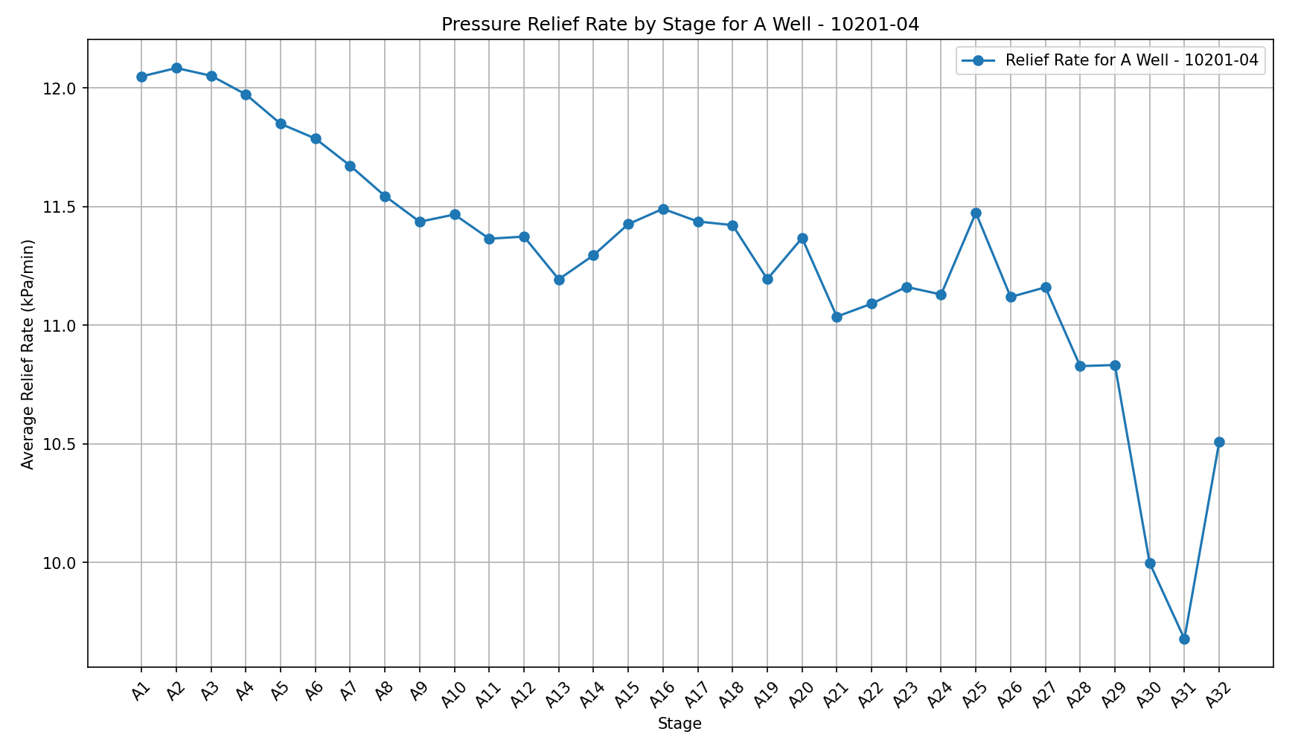
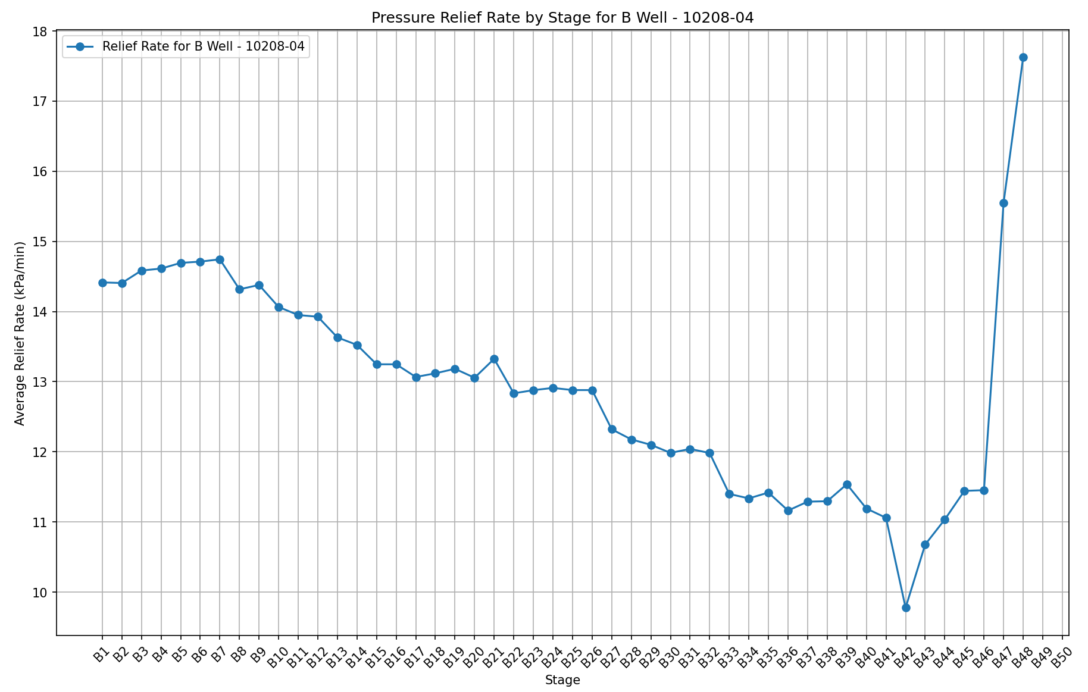
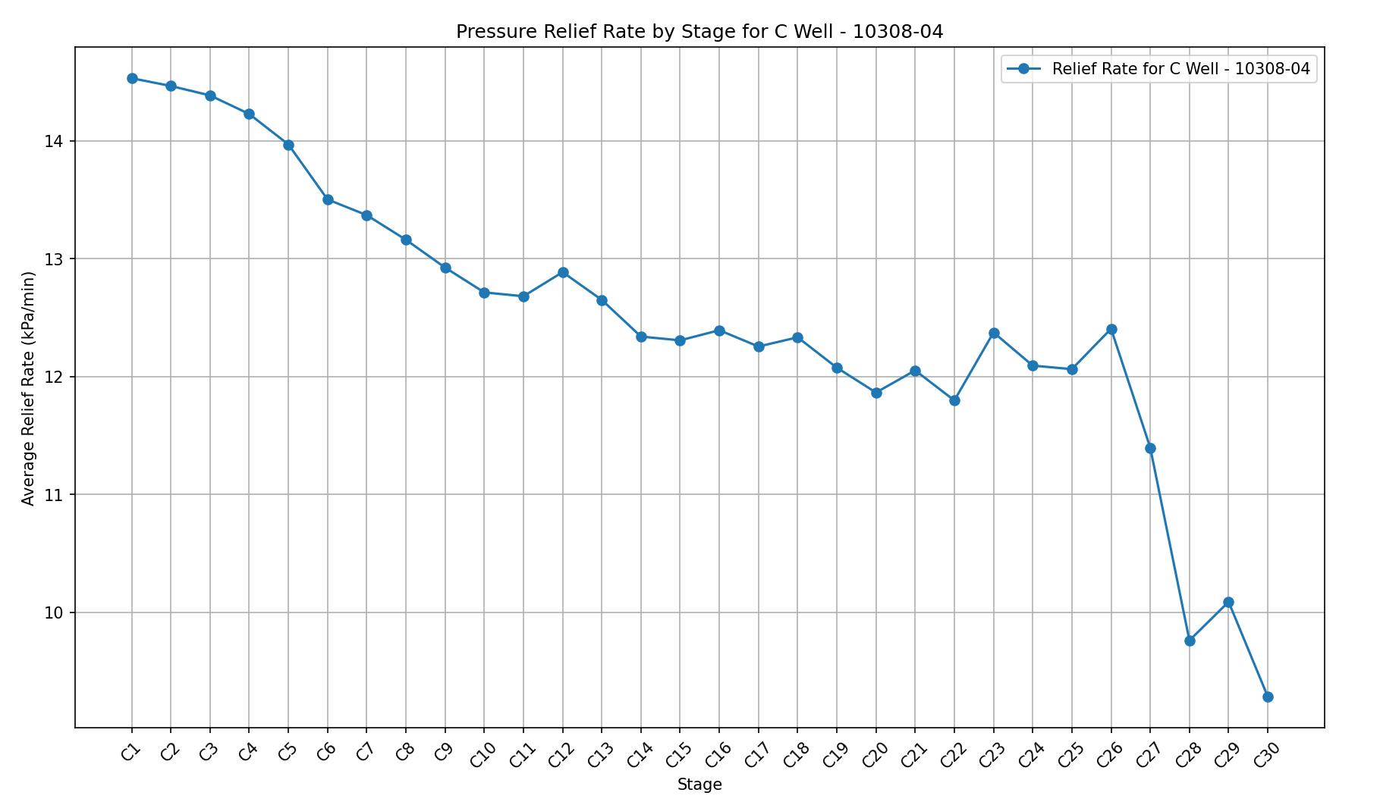
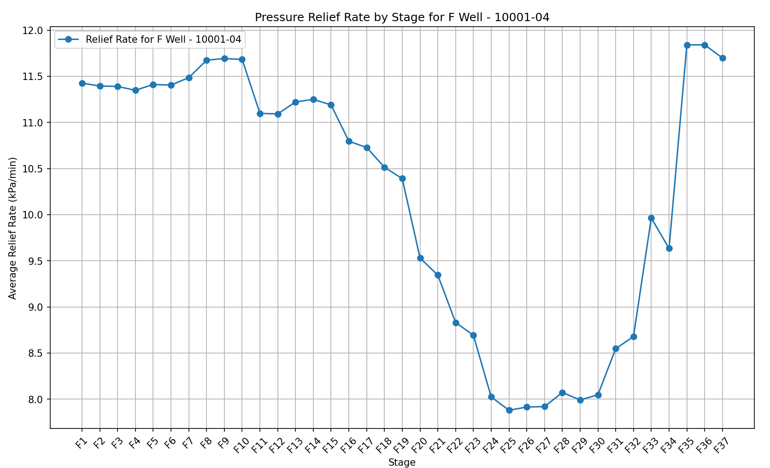
East Target Wells (A,B,C,F)
**Invalid Data** From fracking the bend at high frequency, less relief time
19%
32%
Conclusion: All East target wells had a gradual decrease in the relief rate as the frac progressed (pressure reduced at a slower rate by the end of the frac)
36%
31%

Slide 4
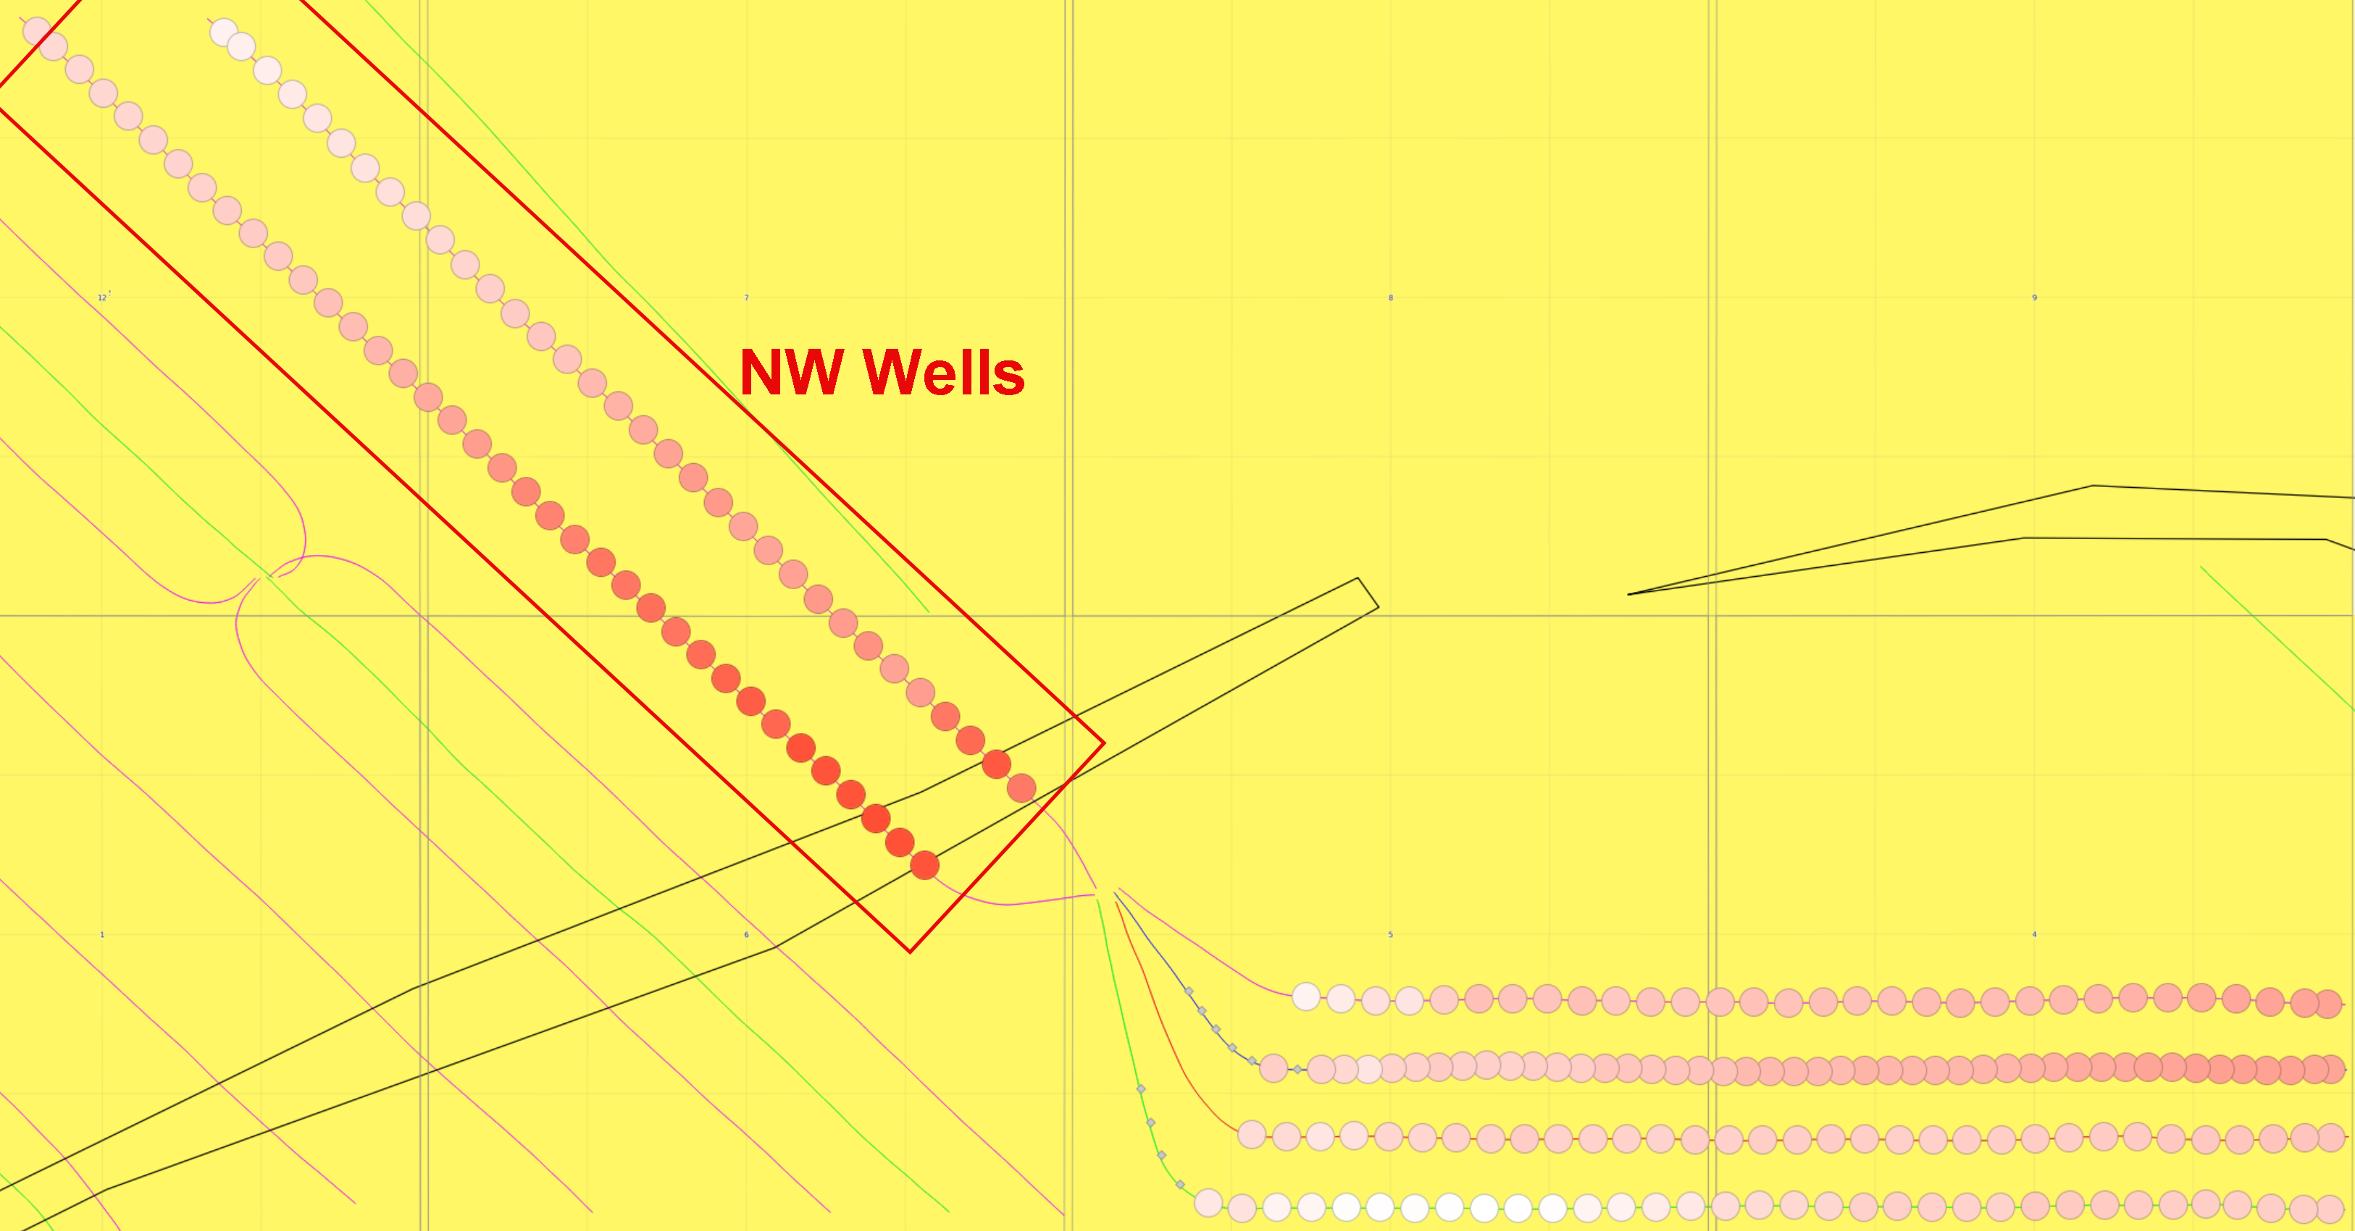
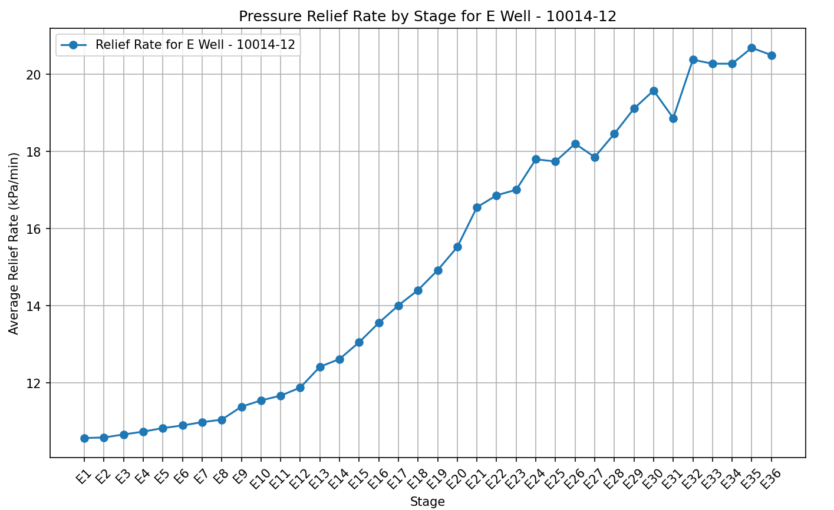
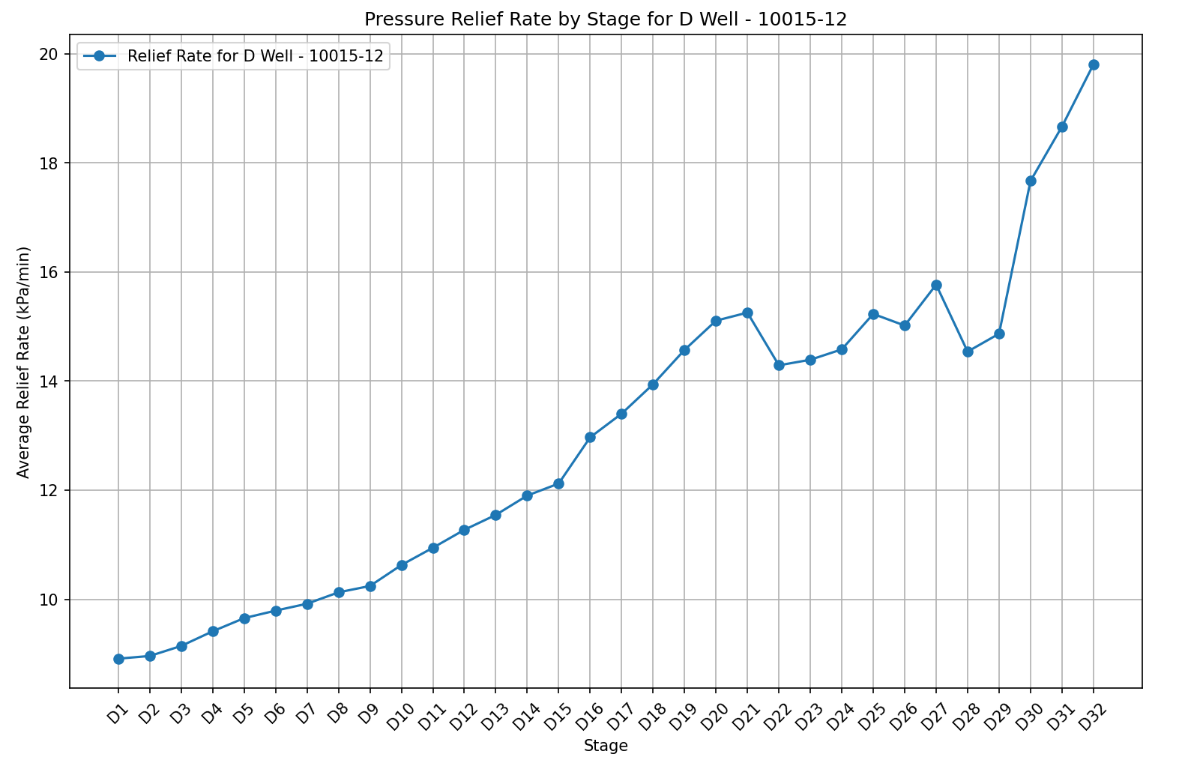
North West Target Wells (E, D)
121%
95%
Conclusion: Both NW target wells showed very strong growth in the relief rate over time (pressure reduced faster by the end of the frac) – with the rate doubling from the start to finish.

Slide 5
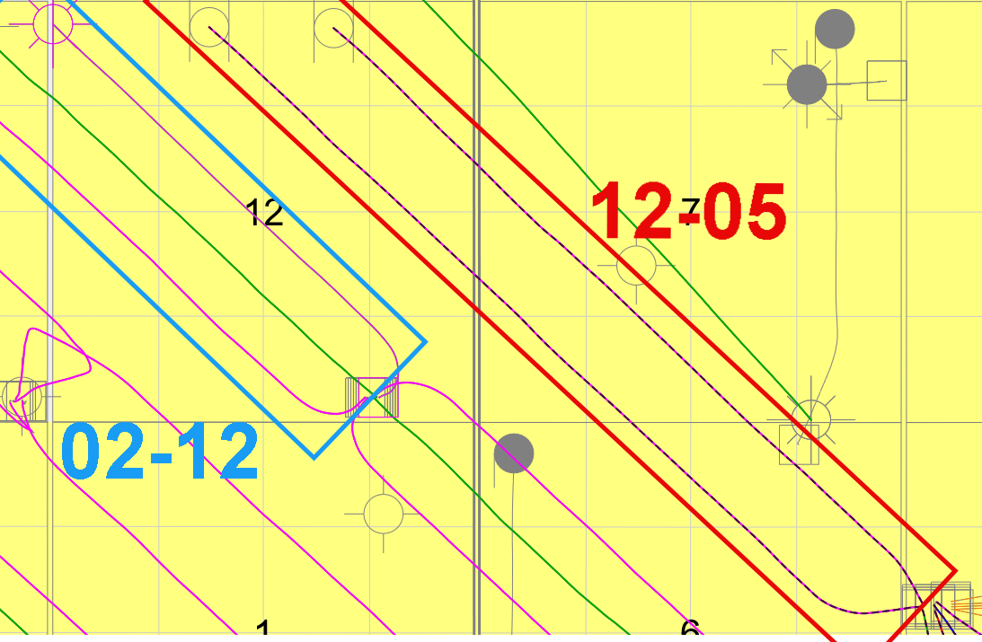
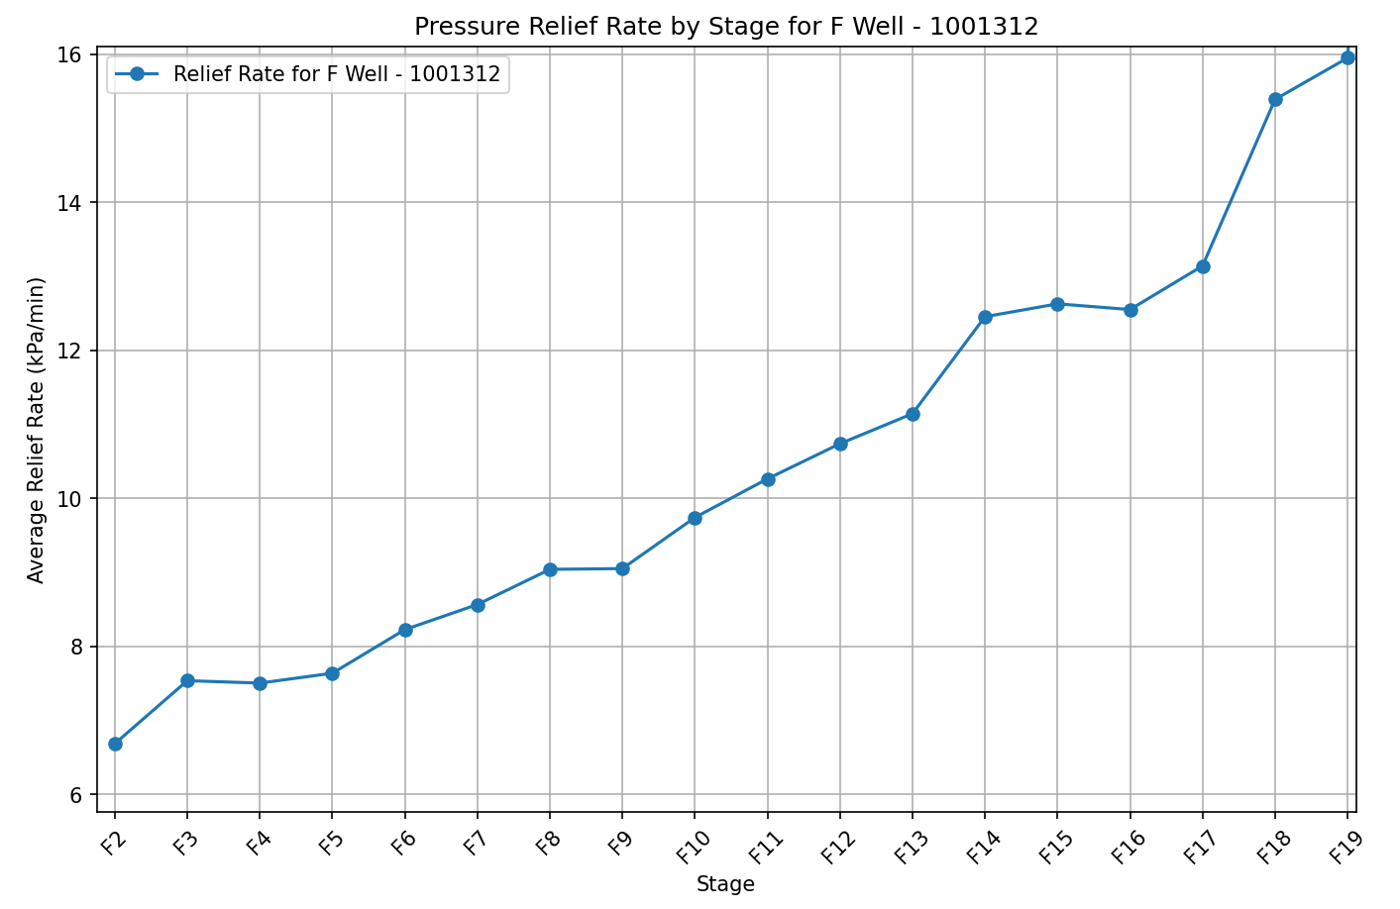
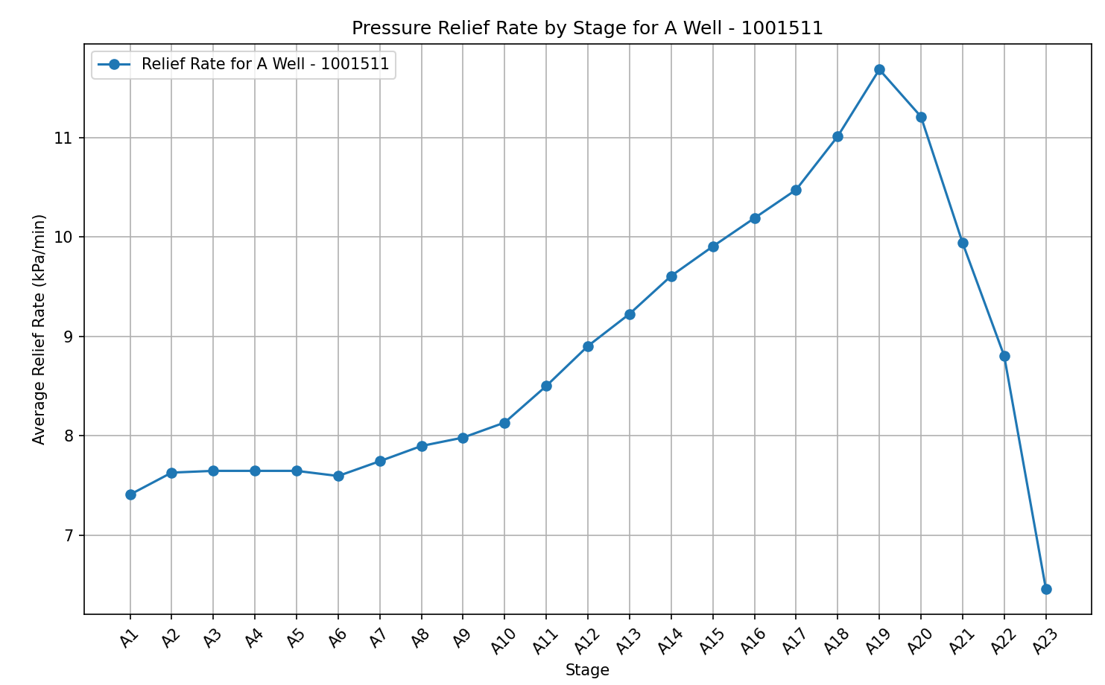
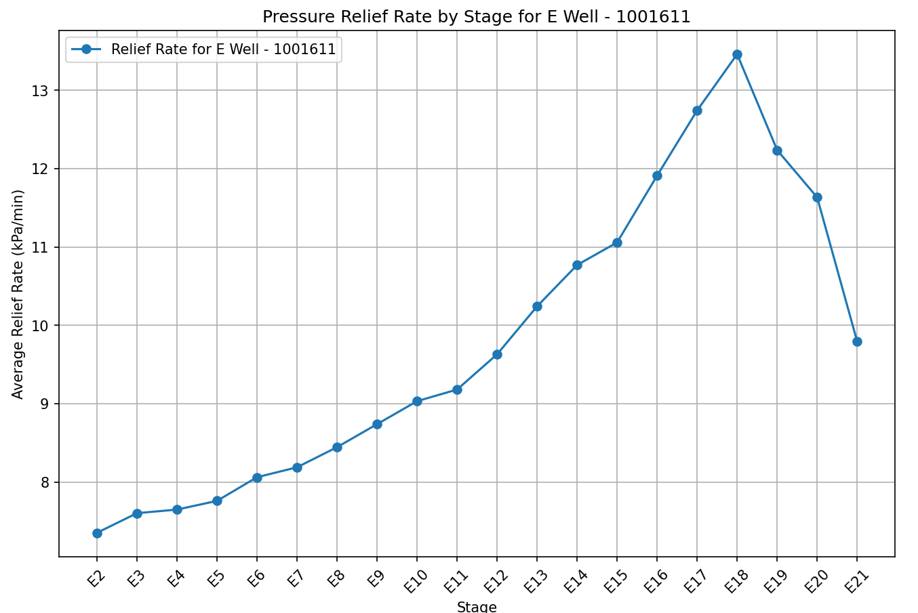
02-12 NW Target Wells
Eastern Most Well (Closest to 12-05)
Other NW Target Wells
137%
Tail end stages start sudden downtrend – change in frac methodology/sequencing?
Conclusion: Closest NW 02-12 well matched 12-05 NW well trends, other two matched initially but started to trend down on the tail end of the frac

